Slide 1
“Reclaiming Innovation: Promoting Student Ownership of Learning Through Social Media”
Name
Title
Affiliation

Slide 2
Student Ownership
LMS
Pros
Cons
Alternatives
Pros
Cons

Slide 3
Social Media
Prezi
Blogs
Facebook
Twitter
Instagram

Slide 4
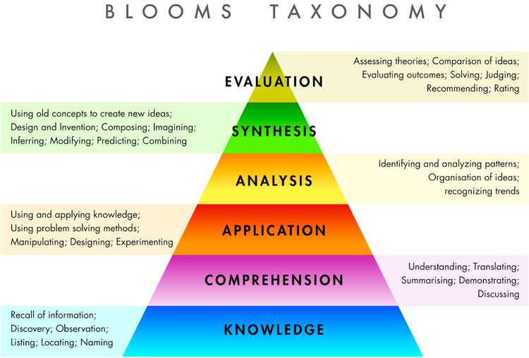
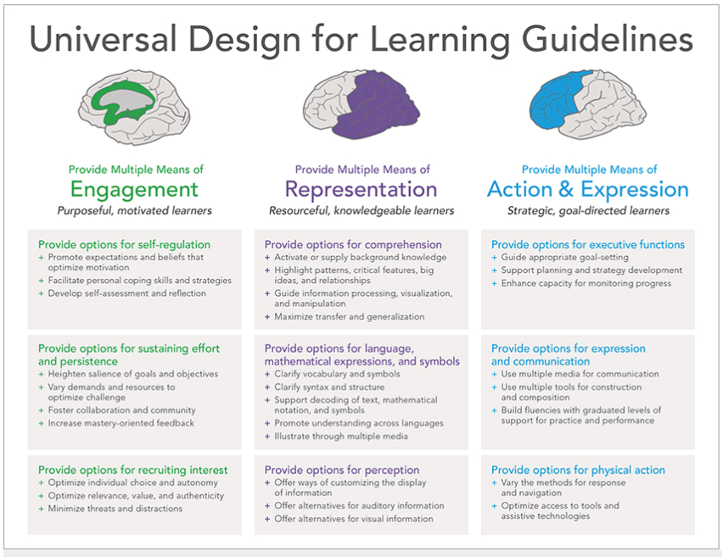
Active Learning
Bloom’s Taxonomy
UDL
https://juliaec.files.wordpress.com/2011/04/blooms_taxonomy.jpg
http://udloncampus.cast.org/page/udl_about#l1970369

Slide 5
Innovation
Future is today
What lies ahead

